Slide 1
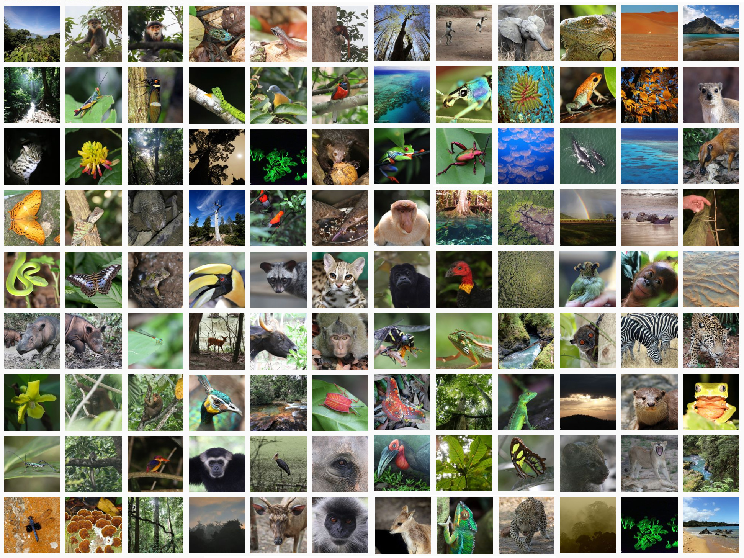
Chapter 1
The Living World

Slide 2
Q. What is living?
Answer:
Living is a distinctive characteristic of a living organism by which it reproduces, grows, exhibits metabolism, sense and respond to stimuli.
In simple language, Organisms that possess life is living
Literally, living is noun and adjective for it is alive (not dead)

Slide 3

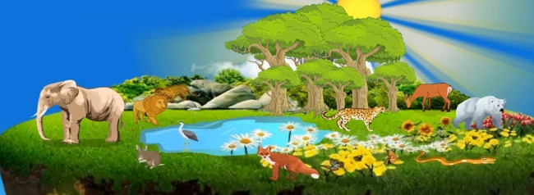
Q. How would you describe living world?
Answer:
Living world is comprised of diversity of living organisms existing in diverse habitats*
*Cold mountains, deciduous forests, oceans, freshwater lakes, deserts, hot spring, etc.

Slide 4
How do living differs from non-living?

Slide 5
Table: Distinguishing features of living and non-living
Characteristics | Living | Non-living
Cellular organisation
Nutrition
Metabolism
Growth
Reproduction
Movement
Respond to stimuli
Living organisms are made up of cell(s). Cells are organised into tissues, tissues form organ and organs form organ system. Organ system forms organisms.
Non-living things are not made up of living cells.
Living organisms take in food to carry various life processes
There is no nutrition in non-living things
Living beings show metabolism i.e exhibit various metabolic reactions (catabolism or anabolism).
Non-living don’t carry metabolism
Internal processes (cell division) lead to growth (increase in mass).
Non-living show external growth
Living organisms reproduce future generations either sexually or asexually.
Non-living doesn’t reproduce
Non-living are static. External forces make them move.
Living forms exhibit movement
Living organisms respond to external stimuli (Animals sense environment by sense organs. Plants respond to temperature, light, water, pollutants ).
Don’t respond to stimuli.

Slide 6
Home assignment
How would you describe the living world?
Distinguish between living organisms and non-living things.
‘Humans are living.’ Justify
Why do we consider chalk as non-living thing?
State five distinctive characteristics of living organisms.

Slide 7
Chapter 1 The Living World
Biodiversity
Biodiversity

Slide 8
Q. What is the meaning of term diversity*?
Answer:
Diversity is the state of being diverse
or
degree of variation.
*Diversity : variety, different

Slide 9
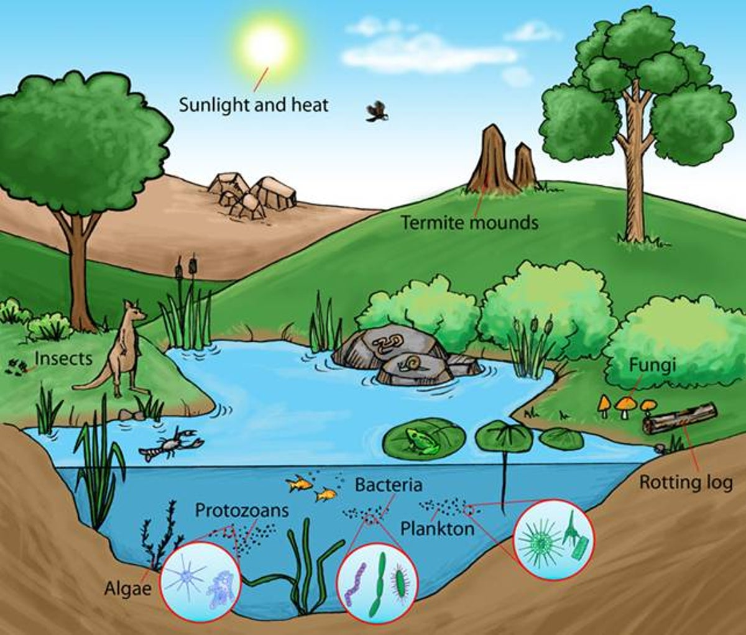
Bio diversity
Life

(Living organisms)
Variety

Slide 10
Q. What is biodiversity?
Answer:
Biodiversity is the existence of a variety of organisms on earth, their relationship among themselves and with the abiotic components.
Biodiversity ensures balanced and more stable ecosystem.
1.7-1.8 millions
species

Slide 11
Q. Why are living organisms classified?
Answer:
Millions of living forms (1.7-1.8 millions) varying in size, shape, colour, habitat and many other characteristics exist on earth. Studying each of them is challenging.
Therefore, scientists have devised taxonomy for systematic and standardised study of living forms easily.

Slide 12
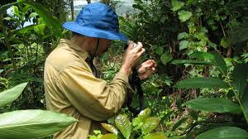
Q. What is taxonomy?
Answer:
A branch of systematic deals with characterisation, identification, naming, and classifying organisms on the basis of characteristic features.
Taxonomy requires intensive laboratory and field studies like collection of specimens.

Slide 13
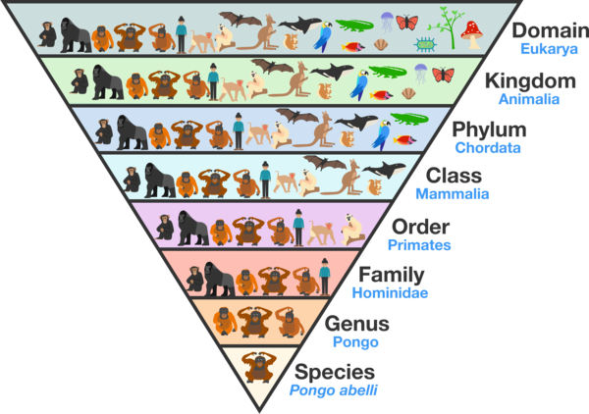
Q. Discuss the processes of taxonomy.
Answer:
Basis processes of taxonomy are:
Characterisation
Identification: recognition of organisms using names.
Classification: Grouping of organisms into categories on the basis of observable characters.
Nomenclature: Process of standardised naming of organisms such that a particular organisms is known by the same name all over the world.

Slide 14
Q. Mention some international organisations that provide and regulate a uniform system of nomenclature.
Answer:
Procedure / principles / criteria or recommendations for naming organisms are provided by;
ICBN: International Code of Botanical Nomenclature
ICZN: International Code of Zoological Nomenclature
ICN: International Code of Nomenclature for algae, fungi, and plants

Slide 15
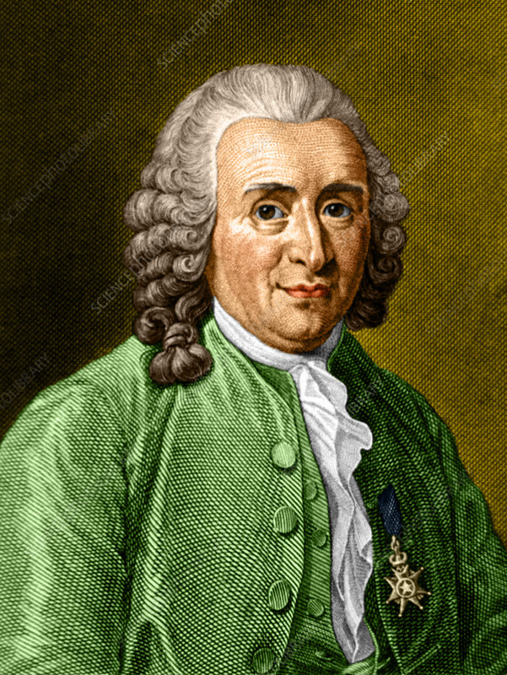
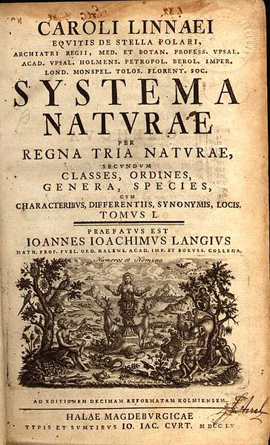
Carolus Linneus
Developed binomial Nomenclature
Example: for mango;
Mangifera indica Linn
Father of modern taxonomy
Published book entitled ‘Systema Naturae’

Slide 16
Scientific name of mango: Mangifera indica Linn
Mangifera
indica
Linn
Generic name
Capitalised
Specific epithet
Written in small letter
Scientist who described the species
Latinised, Italicised, Underlined

Slide 17
Answer the following questions
What is the meaning of term diversity?
What is biodiversity?
Mention some international organisations that provide and regulate a uniform system of nomenclature.
Discuss the basis of processes of taxonomy.
Why are living organisms classified?

Slide 18
Chapter 1 The Living World
TAXONOMIC CATEGORIES

Slide 19
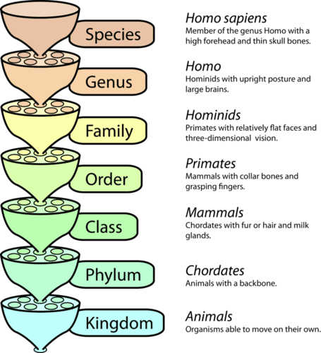
Taxonomic categories*
*Synonym;
Taxa (singular; Taxon),
Groups,
Ranks,
Specific
Decrease in similar characteristics
General

Slide 20
Table Organisms with their Taxonomic categories
Common Name | Biological Name | Genus | Family | Order | Class | Phylum/ Division
Man | Homo sapiens | Homo | Hominidae | Primata | Mammalia | Chordata
Housefly | Musca domestica | Musca | Muscidae | Diptera | Insecta | Arthropoda
Mango | Mangifera indica | Mangifera | Anacardiaceae | Sapindales | Dicotyledonae | Angiospermae
Wheat | Triticum aestivum | Triticum | Poaceae | Poales | Monocotyledonae | Angiospermae

Slide 21
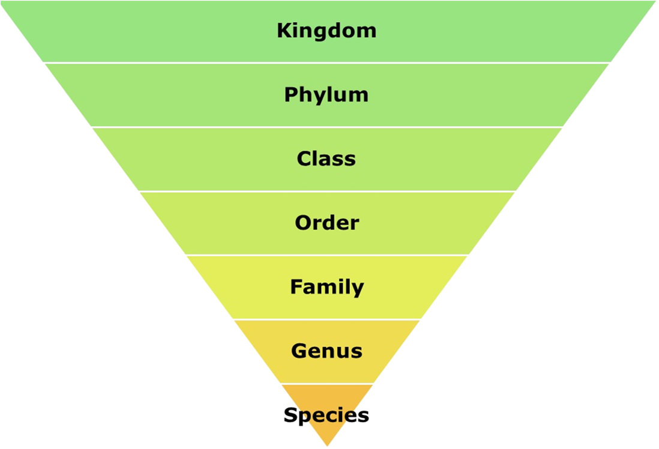
Mnemonic for taxonomy order
King Phillip Can Order For Good Soup

Slide 22
Terminology
Term | Explaination
Species
Genus
Family
Order
Class
Phylum
Kingdom
A group of organisms having similar characteristics and are able to interbreed to produce fertile offspring.
Aggregate of closely related species
Group of related genera
Assemblage of families which exhibits few similar characteristics.
Taxonomic category which include related orders.
Higher taxon characterised by group of classes
Highest rank categorising various phyla

Slide 23
Chapter 1 The Living World
Taxonomical Aids

Slide 24
Taxonomic aids: Techniques, procedures, tools, sources of information that are useful in taxonomy (for identification and classification of organisms)
Herbarium
Storehouse of herbarium sheets
2. Museum
Building for preservation of dead plants and animal specimens in the container/jar by adding preservative solution like[ethanol or isopropyl alcohol, formalin = formaldehyde + water), etc]
3. Botanical garden
Garden for the exhibition and scientific study of plants
4. Zoological park
Ferocious animals are managed within artificial enclosures and displayed to the public for study.
5. Key
May be dichotomous key or polychotomous key
6. Others
Like flora, manuals, monograph, catalogue

Slide 25


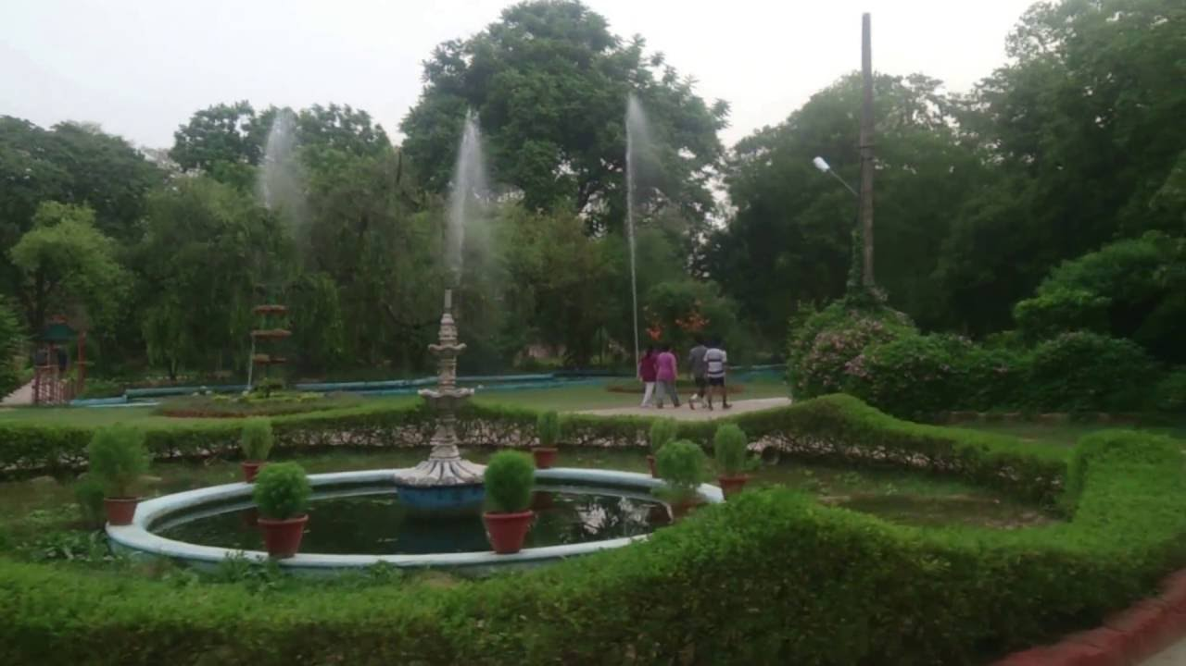
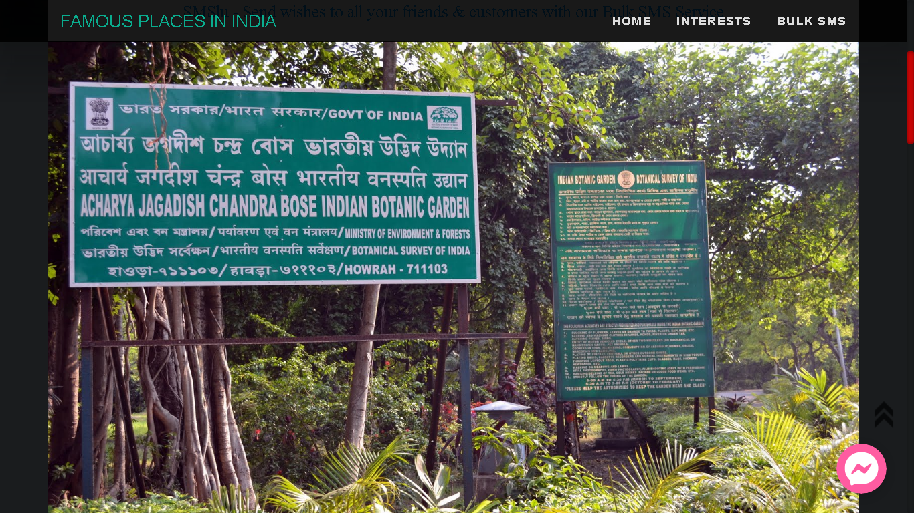
Some famous botanical gardens
Royal Botanical Garden, Kew, United Kingdom
National Botanical Research Institute, Lucknow, UP
Botanical garden, Lucknow, UP
Indian Botanical Garden, Howrah, West Bengal

Slide 26


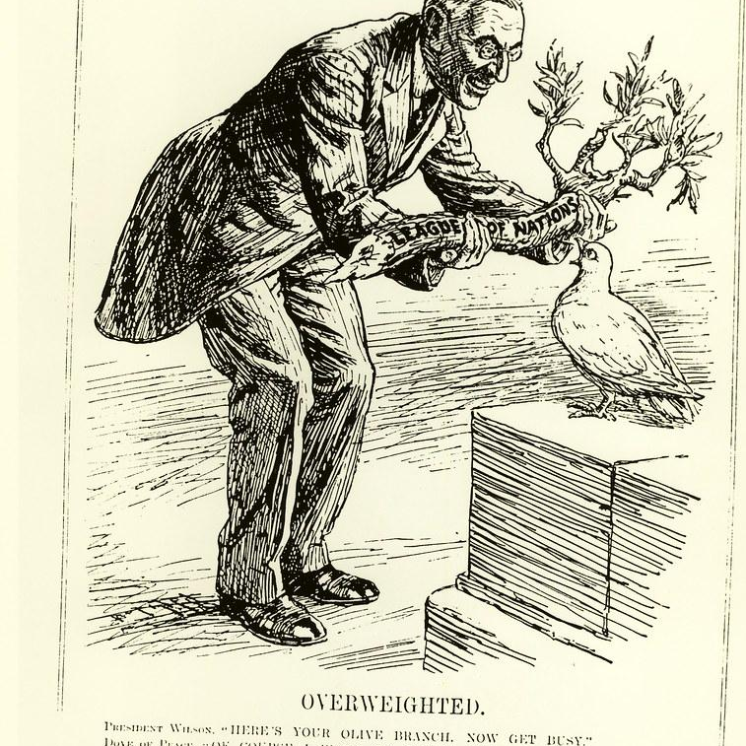
Significance of taxonomic aids
Research
Study
Referrence
Taxonomic aids are useful for students, professionals and public in general for studying about plants, animals and other living organisms
Taxonomic aids like museum, zoological park, botanical garden, etc are useful for referring on the topic or subject of study and research.
Taxonomic aids are useful to scholars in different branches of biology like forestry, agriculture etc.

Slide 27
Dichotomous key as taxonomic aid
*Use couplet (i.e. set of contrasting statement about a characteristic feature)
*Lead is accepted statement, other statement is rejected
For example; Classification of a flowering plant
Character; Presence of flower
Non flowering plants don’t have flower
Flowering plants have flower
The specimen is flowering plant
Rejected statement
Lead
(accepted statement)

Slide 28
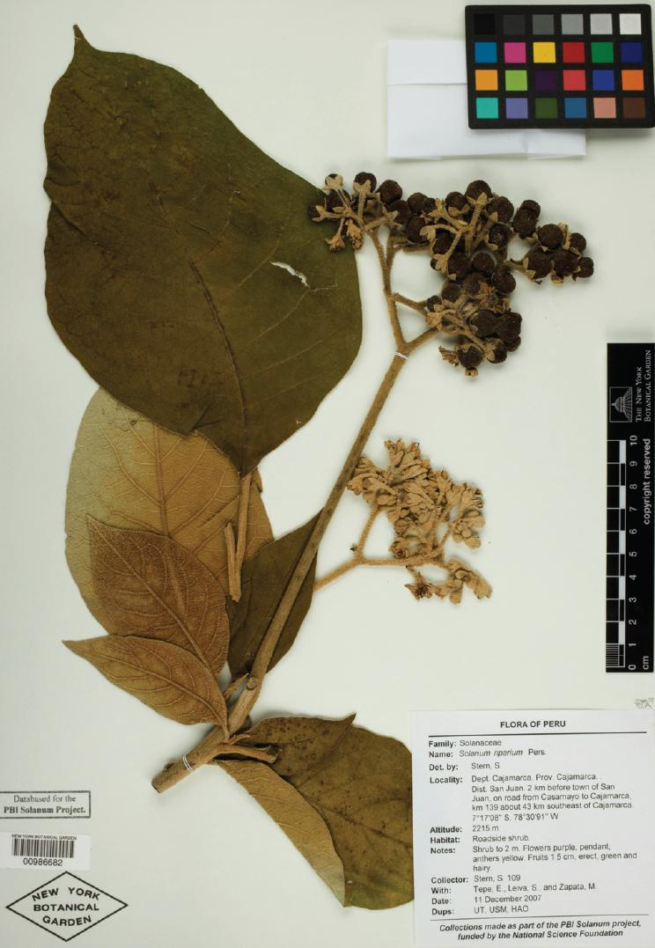
Herbarium sheet
Date
Place of collection
English, local and botanical names
Biological classification details

Slide 29
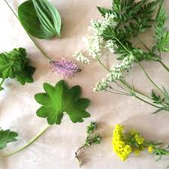
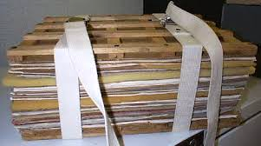
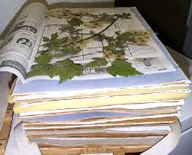
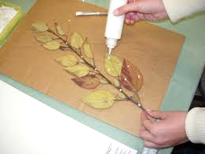
Steps for preparation of herbarium sheet
1. Collection
2. Pressing
3. Drying
4. Mounting
Collection of plant species
Flattening of the desired plant parts between heavy wooden blocks
Drying for almost a month
Mounted on herbarium sheets by mentioning date, place of collection, English, local and botanical names and biological classification details

Slide 30
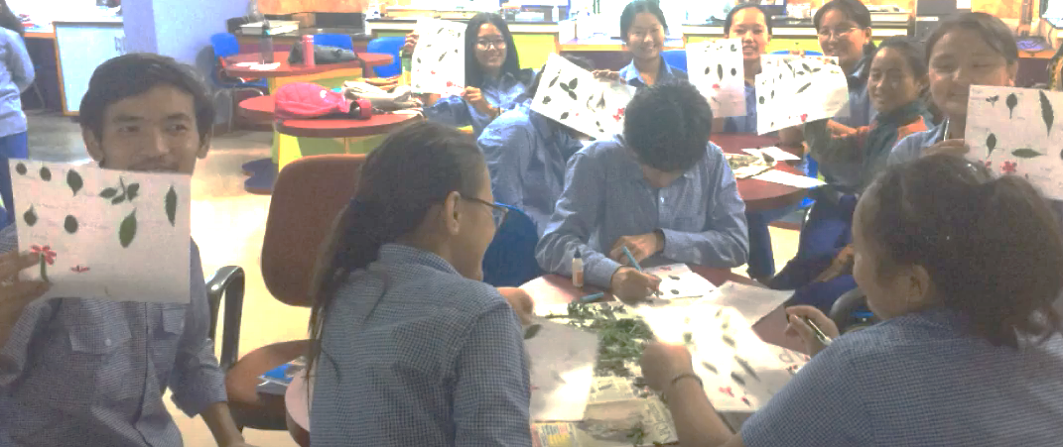
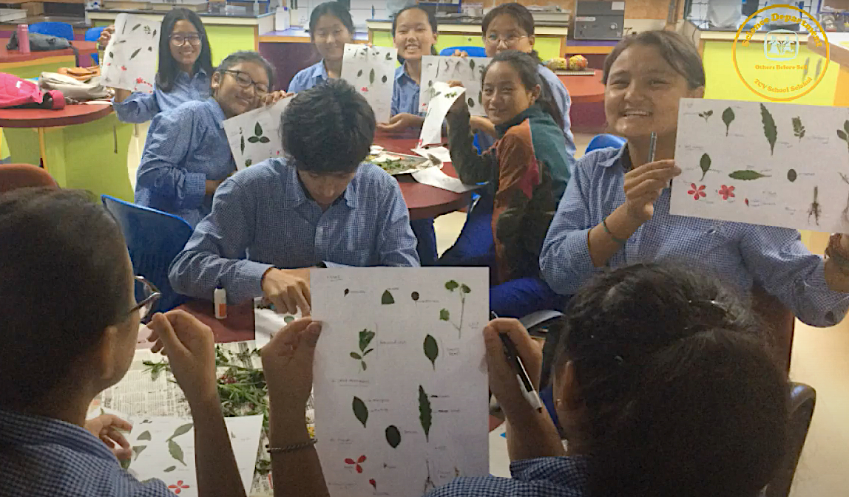
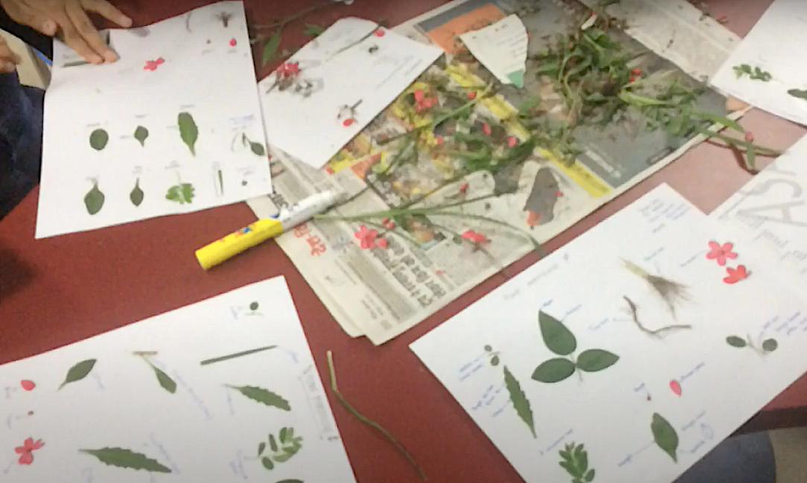
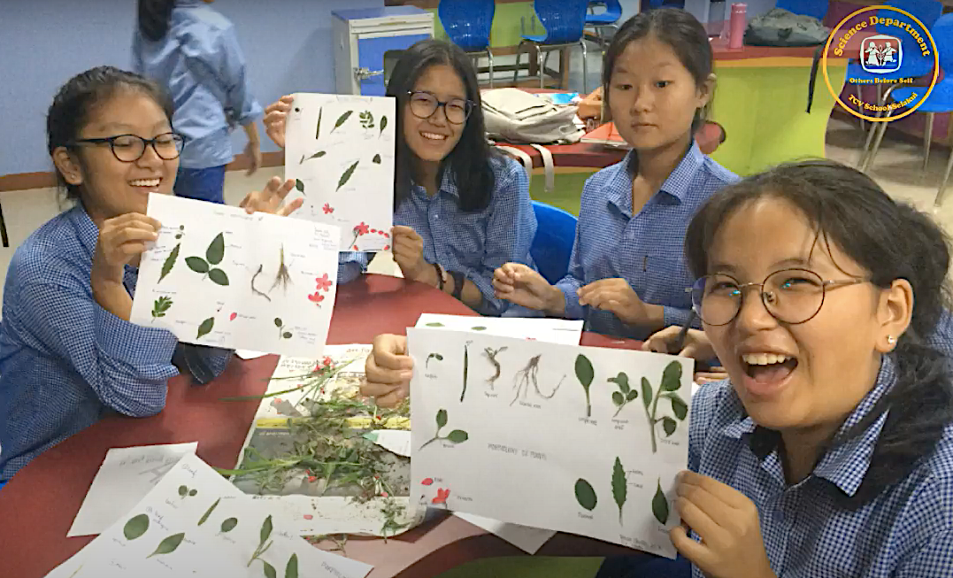
Class XI Biology students preparing simple herbarium sheets

Slide 31
End of the chapter 1

Slide 32
Answer the following questions
1. State the significance of taxonomic aids for scientists.
2. Describe key as taxonomical aids.
3. Illustrate the hierarchy of taxonomic categories for classification of living
organisms.
4. Discuss the steps for preparation of herbarium sheets and its significance.
5. With an example, describe species.

Slide 33

Teacher
Mr. Lhakpa Wangyal
PGT Biology
Email: lhakpawangyal@gmail.com
Contact number: 84497 99894
Social Baluni Public School

